Slide 1


OPIM 5770: Advanced Business Analytics and Project Management
SBM Parameter Optimization for Enhanced Bottle Performance
Team 02
Pranjal Jain | Bhanu Ravindranath Kasturi | Mounitha Ravindranath Kasturi | Abhishek Sakleshpur Dharmashekar Venkata Durga Prasad Poka | Sumit Pal

Slide 2







Meet the team #2
Pranjal Jain
Team Member
Bhanu Ravindranath Kasturi
Team Member
Mounitha Ravindranath Kasturi
Team Member
Abhishek S. Dharmashekar
Sponsor Liaison
Venkata Durga Prasad Poka
Project Manager
Sumit Pal
Team Member
2
2
Project: SBM Parameter Optimization for Enhanced Bottle Performance
2
2

Slide 3
Objective & Methodology of the Analysis
Objective
Current Issue: PepsiCo's blow molding process for PET bottles faces inefficiencies, with SBM recipes causing suboptimal material distribution and excess plastic usage. This increases production costs and conflicts with PepsiCo's 2025 sustainability goals to reduce plastic usage and ensure fully recyclable packaging.​
Objective
To develop a data-driven predictive model (formula) that accurately forecasts bottle performance (output) based on key SBM parameters/section weights (inputs), using comprehensive data analysis and statistical modeling techniques.
Approach
Data Visualization and Pattern Analysis
Development of Predictive Formula – Modeling Framework
Data Processing Data Integration, Handling Missing Data, Duplicate Removal.
Baseline Model Development and Comparison Develop separate models for each bottle type and performance metric, then compare them to identify the best model that works across all bottles and metrics.
Exploratory Data Analysis Univariate Analysis, Box Plots, Correlation Analysis, Statistical Measures.
Standardized Model Development¹ Develop standardized models for thermal, burst, and top load metrics, optimizing hyperparameters for improved performance.
Analysis & Interpretation Pattern Identification, Guidance for Modeling, Actionable Insights with Dashboards.
What-if Analysis Use the model's predictive equation to conduct a What-if analysis.
3
3
3
*: Analysis is performed for AXL and Ripple bottles.; 1: Our focus was shifted to developing Standardized Model as per the sponsor’s requirement.

Slide 4
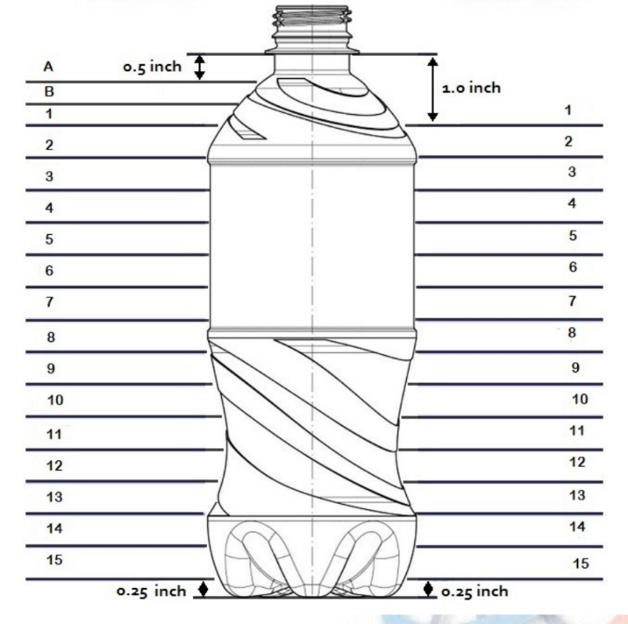

Overview of the dataset, including input features and target variables.
Data Overview
In our analysis, section thickness serves as the input variable, while Thermal Expansion, Empty Top Load and Burst properties are the target variables, allowing us to generate predictive equations for each preform.
Input Variables (X)
Sth1
Sth2
Sth3
Sth4
Sth5
Sth6
Sth7
Sth8
Sth9
Sth10
Sth11
Sth12
Sth13
Sth14
Sth15
Target Variables (y)
Thermal Expansion
Upper Bumper
Upper Panel
Mid Panel
Lower Panel
Lower Bumper
Base
Panel Max Expansion
Empty Top Load
Burst Expansion
Burst Pressure
Shoulder
Label
Local Measure
Section Thickness
Grip
Global Measure
Fig. Bottle locations selected for thickness measurement
Base
The analysis is conducted across four preforms: AXL 21.5g, AXL 20.5g, Ripple DAK 20.5g, and Ripple FENC 20.5g.
4
Color coding is added to show the relationship between sth values and where thermal expansion happen.

Slide 5
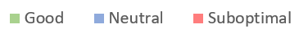
Standardized Model Results – Evaluation by R2
Model Summary
The standardized model demonstrates strong R2 performance across all bottle performance variables for Ripple bottles. However, for AXL bottles, while the model performs well for variables like top load and burst properties, it shows suboptimal results for thermal expansion metrics.
 |  |  |  |  | Model Performance (R2) by Bottle (Train | Test)
 |  |  |  | Standardized Model Type
 |  |  |  |  | 21.5g (AXL) | 20.5g (AXL) | 20.5g (Ripple DAK) | 20.5g (Ripple FENC)
Bottle Performance (Y) | Upper Bumper Expansion |  |  | Random Forest* | (0.57 | 0.44) | (0.45 | 0.13) | (0.99 | 0.96) | (0.99 | 0.92)
 | Upper Panel Expansion |  |  |  | (0.56 | 0.30) | (0.53 | 0.14) | (0.99 | 0.97) | (0.99 | 0.91
 | Mid Panel Expansion |  |  |  | (0.55 | 0.29) | (0.10 | 0.01) | (0.96 | 0.94) | (0.99 | 0.81)
 | Lower Panel Expansion |  |  |  | (0.41 | 0.25) | (0.09 | 0.02) | (0.98 | 0.86) | (0.84 | 0.70)
 | Lower Bumper Expansion |  |  |  | (0.75 | 0.52) | (0.86 | 0.14) | (0.98 | 0.85) | (0.98 | 0.72)
 | Base Expansion |  |  |  | (0.75 | 0.33) | (0.27 | -0.05) | (0.28 | 0.20) | (0.95 | 0.53)
 | Panel Max Expansion |  |  |  | - | - | (0.97 | 0.71) | (0.98 | 0.73)
 | Empty Top Load |  |  | Linear Regression | (0.99 | 0.98) | (0.87 | 0.86) | (0.65 | 0.50) | (0.78 | 0.51)
 | Burst Expansion |  |  | Linear Regression | (0.99 | 0.98) | (0.99 | 0.99) | (0.97 | 0.92) | -
 | Burst Pressure |  |  |  | (0.97 | 0.93) | (0.98 | 0.98) | (0.97 | 0.95) | -
KEY TAKEAWAYS
Burst Expansion models show excellent performance (R² > .90 for both train and test), across all bottle types, demonstrating high consistency in predictions for this feature.
Performance disparities between different bottle types, such as Lower Bumper Expansion and Mid Panel Expansion, highlight the varying impact of model choice and data quality on different product lines.
While Random Forest models excel in some categories, particularly for Lower Panel Expansion, Linear Regression models with regularization offer strong performance in metrics like Empty Top Load and Burst Expansion.
Model Performance:
5
1: In this case, model hyperparameters are different for each performance metrics of thermal expansion. 2: Train-Test Split: 80-20
Notes:
for developing the models we used a split of 80:20 for our train and test dataset respectively.
The model performance are marked as good , neutral and suboptimal in the slide.
For standard models , we chose random Forest models in thermal expansion metrics
Whereas , Linear Regression proved robust for metrics like Empty Top Load and Burst properties.
Our standardized models demonstrated strong R² performance across most Ripple bottle variables. showing high accuracy and reliability.
For AXL bottles, while the models performed well for top load and burst properties, the results for thermal expansion were less optimal for both the AXL preforms.
Some key takeaways include:
Burst Expansion models showed exceptional performance, with R² values for test data close to 0.9 across all bottle types.
Good , optimal , suboptimal details model evaluation metric - r2 score
Hyperparameter changes for each model
After framework
Insights

Slide 6

Standardized Model Development

Slide 7









Workflow for Standardized Model Development and Optimization
Workflow
The flowchart outlines a structured model development process, from data processing and feature selection to predictive modeling, hyperparameter tuning, and final model optimization. The process culminates in actionable insights and strategic recommendations through "What-if" analysis.
Data from PepsiCo Team
Data Processing
(Creation of Single dataset with all 4 bottle preform data)
EDA & Feature Engineering
Feature Selection
Here, user can input sth1 to sth15 values and predict the expected bottle performance (y variable).
Baseline Modeling¹
Best Baseline Model
Recommendations
What-if Analysis
Final Model Selection & Save it.
Model Hyperparameter Tuning
7
1: Base Line models: Basic LR, DT, RF, XGBoost, etc. models without any hyperparameter tuning.)

Slide 8
Sth2, Sth3, Sth4 and Sth5 are important across multiple preforms, indicating that these sections are consistently critical for thermal expansion and bottle performance.
Thermal Expansion
The analysis emphasizes that targeting key section thickness values (especially Sth2, Sth3, Sth4, and Sth5) in specific bottle regions offers a data-driven way to optimize material distribution, reduce excess plastic, and maintain performance standards.
Top 5 Section Thickness Value by Bottle Type & Y variable – Based on Feature Importance
Upper Bumper Expansion
Upper Panel Expansion
Middle Panel Expansion
Lower Panel Expansion
Lower Bumper Expansion
Base Expansion
Panel Max Expansion
8
Note: Above feature importance values as based on Standardized Random Forest Model.

Slide 9
Having a balanced thickness distribution is crucial for optimal performance in Empty Top Load, Burst Pressure, and Expansion.
Top Load & Burst Tests
While the thickness of the Grip and Shoulder sections plays a more critical role in Empty Top Load performance, the Label and Grip sections are key for Burst Pressure and Burst Expansion. The overall distribution of thickness throughout the entire bottle determines the maximum Empty Top Load and Burst Pressure.
Empty Top Load
Burst Pressure and Burst Expansion
Top Section Thickness Influencing Empty Top Load
Top Section Thickness Influencing Burst Pressure
KPI Rank | AXL 20.5g | AXL 21.5g | Ripple DAK 20.5g | Ripple FENC 20.5g
1 | sth13 | sth11 | sth11 | sth10
2 | sth15 | sth13 | sth8 | sth1
3 | sth2 | sth7 | sth13 | sth15
4 | sth12 | sth2 | sth14 | sth2
5 | sth7 | sth14 | sth5 | sth12
KPI Rank | AXL 20.5g | AXL 21.5g | Ripple DAK 20.5g
1 | sth15 | sth7 | sth15
2 | sth11 | sth8 | sth6
3 | sth2 | sth10 | sth11
4 | sth13 | sth2 | sth14
5 | sth14 | sth11 | sth1
Top Section Thickness Influencing Burst Expansion
KPI Rank | AXL 20.5g | AXL 21.5g | Ripple DAK 20.5g
1 | sth3 | sth5 | sth6
2 | sth11 | sth10 | sth15
3 | sth15 | sth3 | sth4
4 | sth13 | sth11 | sth11
5 | sth4 | sth10 | sth10
The performance of the Empty Top Load is primarily determined by the weakest sections of the bottle, namely the Grip and Shoulder sections. Since all the thicknesses are interdependent—where a decrease in one leads to an increase in another—it is important to ensure sufficient material distribution in the Grip and Shoulder sections without compromising the other areas too much.
For Bust Pressure and Burst Expansion, the thicknesses at Label and Grip sections play the most important role. However, it is crucial to ensure sufficient thickness throughout the entire bottle to meet the criteria for both burst pressure and expansion.
9
Note: Above top thickness values are derived from the Modelling results for the respective metrics.

Slide 10
Given the same input (sth values), the model predicts that the AXL 21.5g preform will have the lowest thermal expansion when compared to the other 20.5g preform bottles.
What-if
Recommendation: Both 20.5 ripple bottles (DAK and FENC) exhibit similar thermal expansion for the same input (section thickness), with FENC showing slightly lower thermal expansion than DAK. Therefore, it is recommended to use FENC over DAK for reduced thermal expansion.
Model Input
Section Thickness | Sth1 | Sth2 | Sth3 | Sth4 | Sth5 | Sth6 | Sth7 | Sth8 | Sth9 | Sth10 | Sth11 | Sth12 | Sth13 | Sth14 | Sth15
Value¹ | 0.2499 | 0.2374 | 0.27 | 0.2786 | 0.2793 | 0.2799 | 0.2784 | 0.288 | 0.3156 | 0.3129 | 0.3046 | 0.252 | 0.2016 | 0.2069 | 0.2133
What-if Model Output
Thermal Expansion (%)
Burst Properties
Empty Top Load (N)
10
Note: Above performance metric values are based on Standardized Models for each metric; 1: Mean of Sth values from the dataset provided was leveraged to calculate this.

Slide 11
Detailed Model Development Process

Slide 12
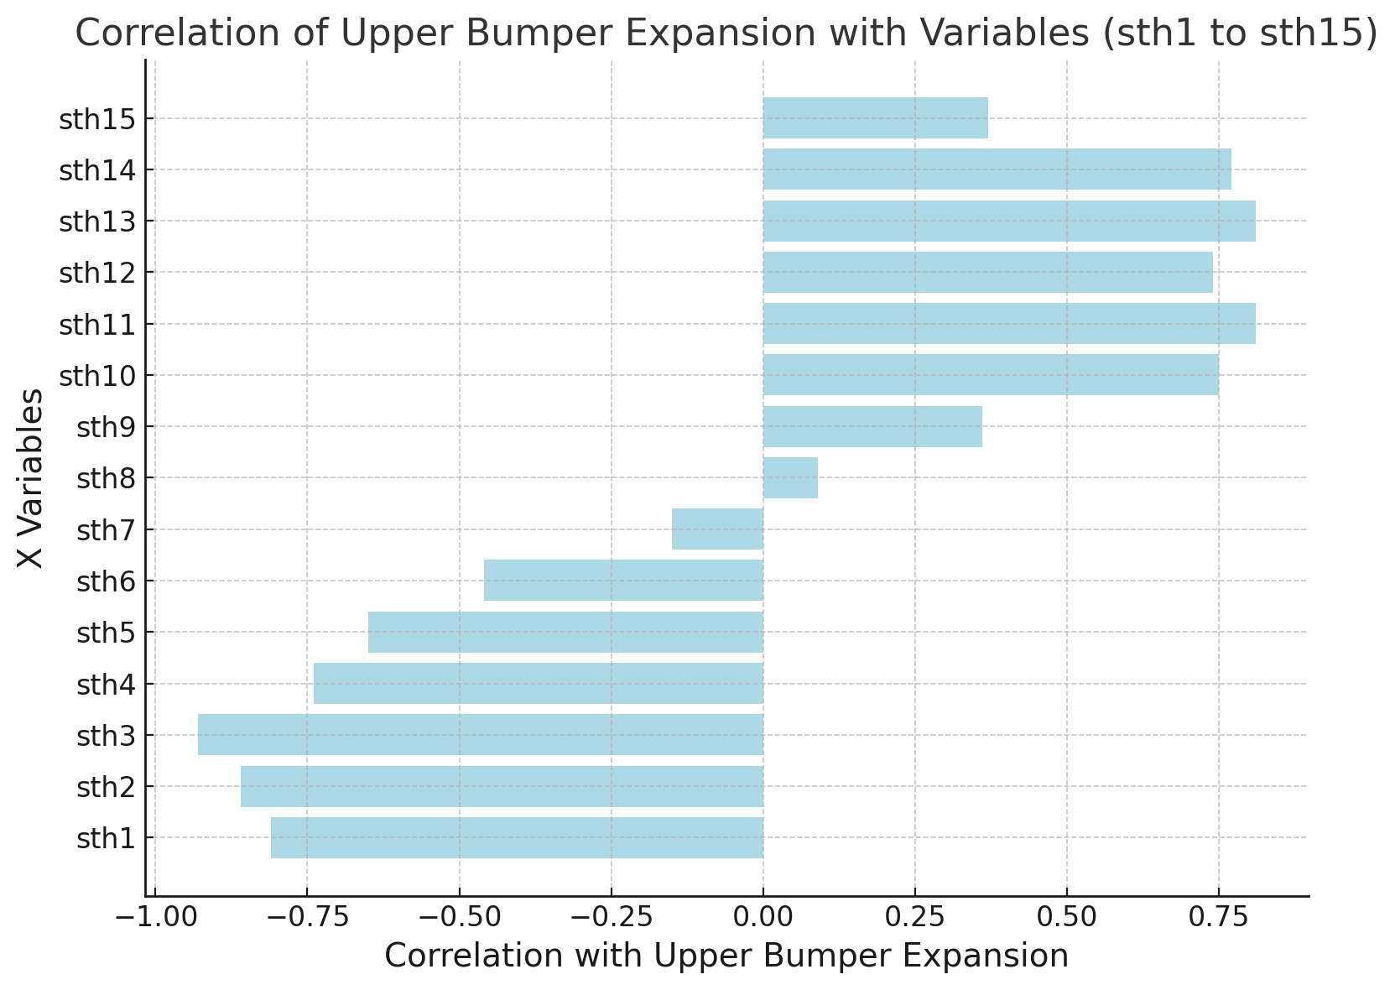
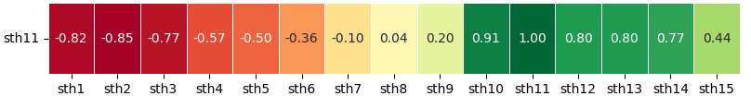
For Upper Bumper Expansion, Sth1, Sth2, Sth3, Sth4, and Sth5 exhibited the highest correlations, so these variables were chosen for baseline modeling.
Upper Bumper Exp.
The slide emphasizes selecting variables with high correlation to the target variable while excluding highly correlated input variables to prevent multicollinearity. This ensures more accurate baseline modeling for Upper Panel Thermal Expansion.
1. Model Input & Target Variables
3. Variable Selection for Baseline Models
X Variables | sth1, sth2, sth3…….. sth15 (Section Thicknesses)
Y Variable | Upper Bumper Thermal Expansion
Top X Variables
For our baseline models, we chose to include sth1, sth2, sth3, sth4, and sth5 for the Upper Panel Thermal Expansion.
2. Correlation b/w Input & Target Variable
Why did we drop high correlation metrics like sth10, sth11, sth12, etc.?
For example, correlation between sth11 and rest of the x variables:
High –ve correlation¹
Sth1 to Sth5 has high correlation with Upper Bumper Expansion.
With the weight (w) remaining constant at 20.5g, as the upper section of the bottle becomes thicker, the lower section tends to become thinner. Hence, the –ve correlation.
Therefore, to prevent multicollinearity, variables that are highly correlated are excluded from the baseline models.
12
1: Correlation > |0.6| is considered as high correlation in our analysis.

Slide 13
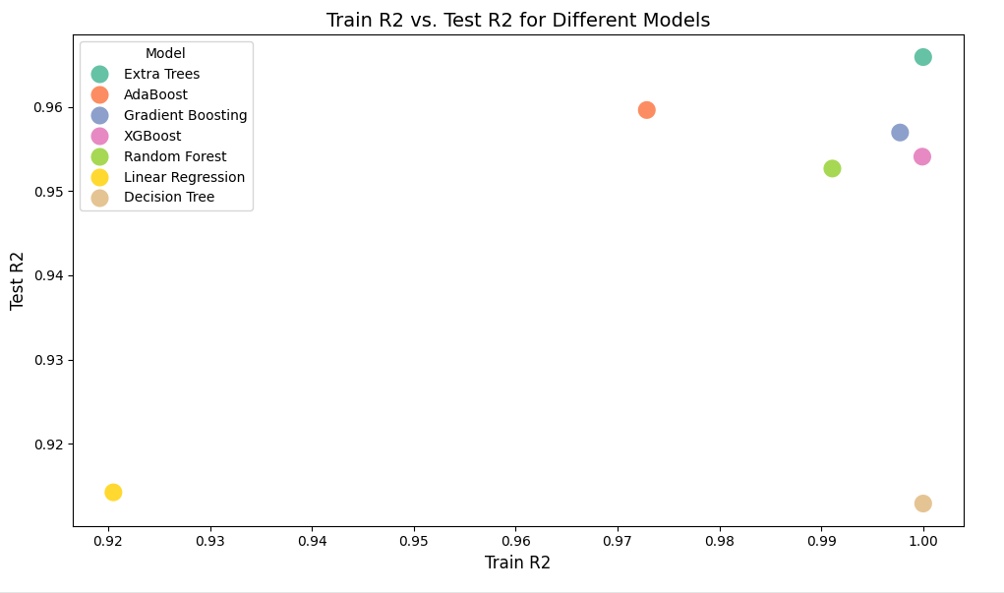
The Random Forest model has been chosen as the best standardized model for Upper Bumper Expansion.
Upper Bumper Exp.
Random Forest model was selected for its strong performance across various bottle preform types and thermal expansion metrics. Attempts to enhance the model with additional features, such as interaction terms and rate of thickness change, led to a drop in performance.
4. Baseline Modeling with selected inputs
5. Baseline Model Selection & Additional Feature Engineering
X Variables | sth1, sth2, sth3, sth4 and sth5 (Selected based on previous slide)
Y Variable | Upper Bumper Thermal Expansion
Why did we choose Random Forest?
Objective: The aim was to select a standardized model that could deliver optimal performance across various bottle preform types and thermal expansion metrics.
Reason for Choosing Random Forest: Random Forest demonstrated strong and consistent results across all preform types and thermal expansion metrics, making it the ideal choice for this task.
80:20 Train-Test Split¹
Baseline Model Results
Is there potential to enhance the model through additional feature engineering?
(0.99, 0.95)
Metric Type | Example | Model Results
Interaction Terms | Sth1*sth2, sth1*sth2*sth3 | Drop in model performance
Rate of Thickness Change | (sth1 – sth2)/sth1 | Drop in model performance
Including the additional features did not improve the results, so decided to proceed with the values from sth1 to sth5.
13
1: Multiple model split was tested such as 80:20 split, 50:50 split, etc. In this case, 80:20 split resulted the best model results.

Slide 14
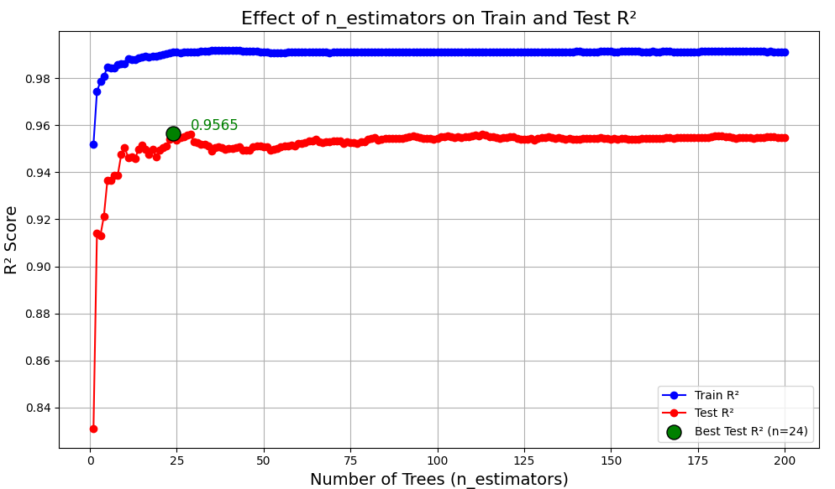
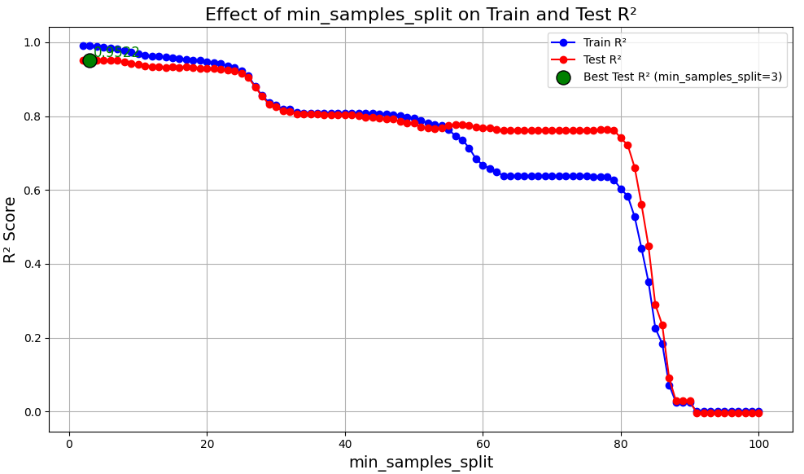
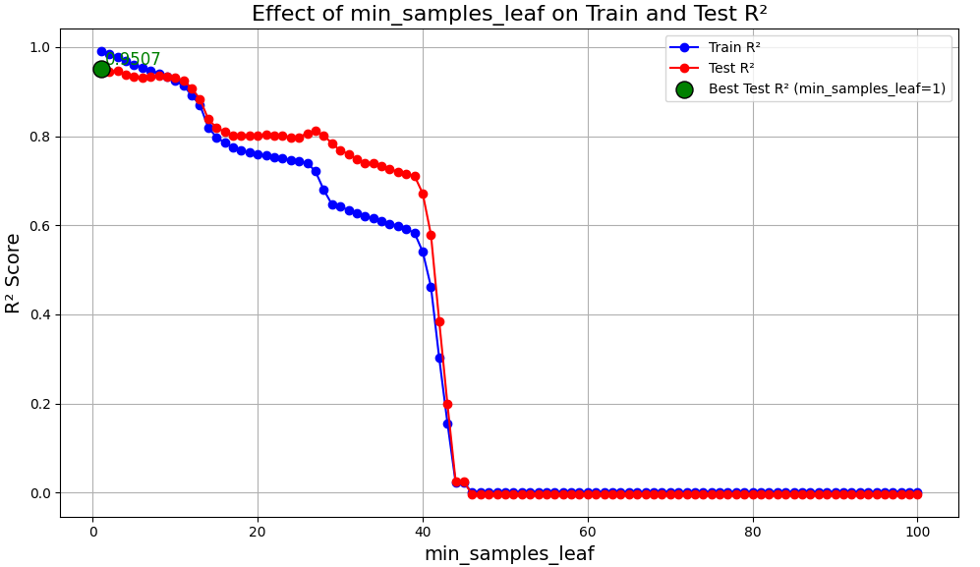
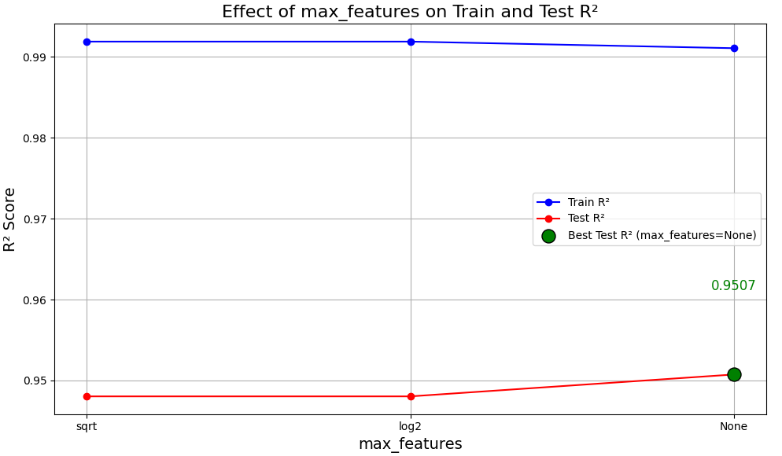
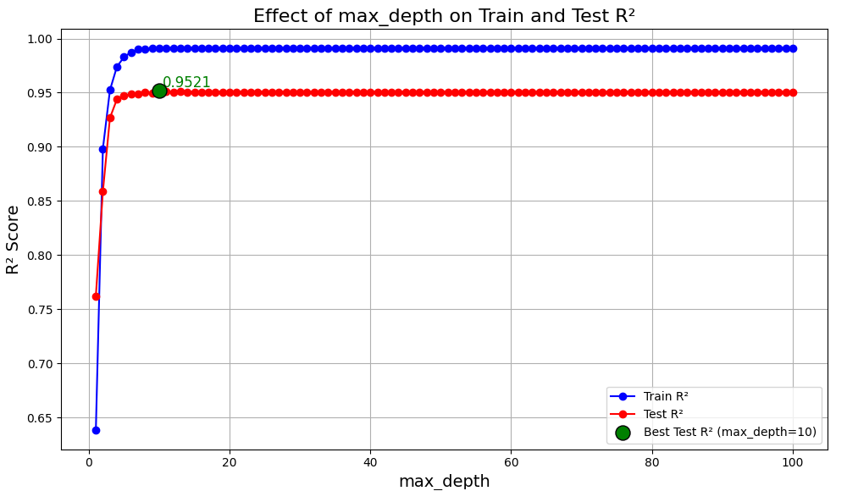
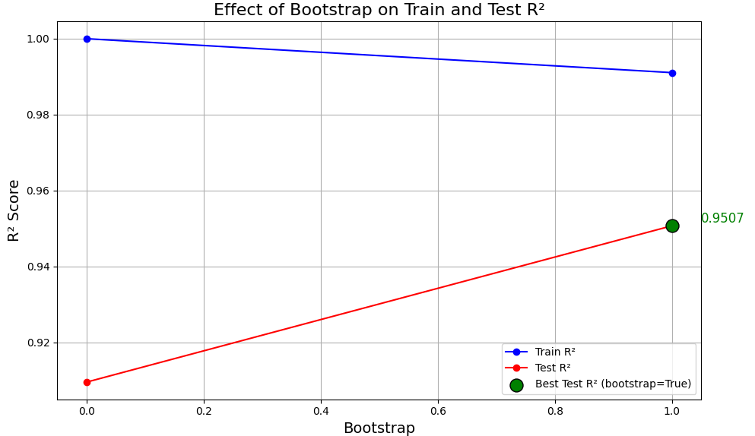
For Upper Bumper Expansion, after hyperparameter tuning, the Random Forest model achieved a train R2 of 0.99 and a test R2 of 0.96.
Upper Bumper Exp.
The model achieved the best R2 results with the Random Forest using optimal parameters: n_estimators = 24, min_samples_split = 3, min_samples_leaf = 1, max_depth = 10, bootstrap = True, and random_state = 42.
6. Model Hyper Parameter Tuning
14
1: Multiple model split was tested such as 80:20 split, 50:50 split, etc. In this case, 80:20 split resulted the best model results.

Slide 15
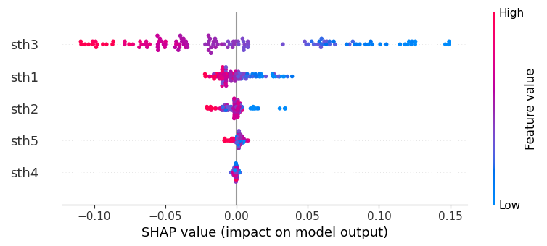
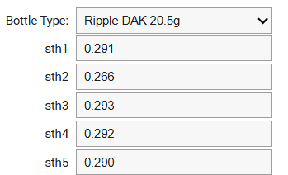
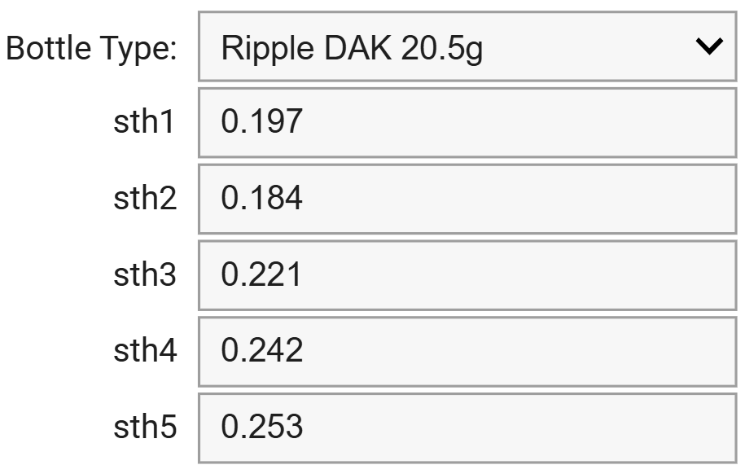

For Upper Bumper Expansion, sth3 is the most influential feature, followed by sth1 and sth2.
Upper Bumper Exp.
The SHAP analysis reveals that sth3 has the greatest impact on predicting Upper Bumper Expansion, and the What-If Analysis setup closely forecasts actual values, demonstrating its effectiveness for automating predictions and optimizing bottle performance.
7. SHAP - Variable Importance
8. What-If Analysis
Based on the data provided, minimum and maximum upper bumper expansion are:
Upper Bumper Expansion | sth1 | sth2 | sth3 | sth4 | sth5
0.394 (Min) | 0.291 | 0.266 | 0.293 | 0.292 | 0.290
0.787 (Max) | 0.197 | 0.184 | 0.221 | 0.242 | 0.253
Using our What-If analysis setup, we can forecast the upper bumper expansion based on the input values for sth1 to sth5:
sth3 is the most influential feature in predicting Upper Bumper Expansion, as it exhibits the highest impact on the model's output according to its SHAP values.
The predicted values from our What-If Analysis setup closely match the actual values, demonstrating that the model performs exceptionally well in forecasting Upper Bumper Expansion. Therefore, we recommend utilizing the What-If Analysis setup to automate the prediction process in this case.
15
1: Multiple model split was tested such as 80:20 split, 50:50 split, etc. In this case, 80:20 split resulted the best model results.

Slide 16
Recommendations

Slide 17



Observations & Recommendations
To conclude, the Hybrid Approach and ML-Based WHAT-IF Approach are applied depending on the performance of the model for each bottle type and performance metric, with traditional simulation used where the model does not perform well.
Process Automation using ML Model’s WHAT-IF Capability
1
 | Standard Model Performance
Performance Metric | Ripple Bottles | AXL Bottles | Recommendation
Thermal Expansion | Strong performance | Poor performance | Hybrid Approach: Ripple: Use WHAT-IF feature of standardized model. AXL: Use traditional simulation.
Empty Top Load | Poor performance | Strong performance | Hybrid Approach: Ripple: Use traditional simulation. AXL: Use WHAT-IF feature of standardized model.
Burst Properties | Strong performance | Strong performance | ML-Based WHAT-IF Approach: Use WHAT-IF feature for both AXL and Ripple bottles.
ML’s What-If
Traditional Simulation Method
17
Recommendation 1 included.

Slide 18


Observations & Recommendations
The 21.5g AXL bottle is overengineered, with no thermal failures, and optimizing the 20.5g AXL bottle can eliminate failures while reducing plastic usage, aligning with PepsiCo’s pep+ initiative. For Ripple 20.5g bottles, selecting FENC over DAK is recommended, as FENC-based bottles show lower thermal expansion for the same thickness.
Which preform to use – 21.5g or 20.5g?
Which material to use for Ripple 20.5g – DAK or FENC?
2
3
Thermal Expansion:
<<<
Burst Expansion:
<<<
The 21.5g AXL bottle appears to be overengineered, as data indicates it experiences no thermal failures.
In contrast, the 20.5g AXL bottles do have some failures, but in most cases, their performance metrics remain within the safe range.
By optimizing the sth values for the 20.5g AXL bottles, we can eliminate these failures and avoid the need for the 21.5g AXL bottle.
This approach aligns with PepsiCo’s pep+ initiative to reduce plastic usage.
Thermal Expansion:
>>>
v/s
It is advised to select FENC over DAK when choosing PET producers.
For equivalent thickness values, FENC-based ripple bottles exhibit relatively lower thermal expansion compared to DAK.
This conclusion is derived using the standard Model’s What-If capability analysis.
AXL 21.5g
AXL 20.5g
Ripple 20.5g DAK
Ripple 20.5g FENC
AXL 21.5g
AXL 20.5g
18
Recommendation 2 & 3 included.

Slide 19
Thank you!

Slide 20
Appendix

Slide 21
Descriptive Analysis

Slide 22
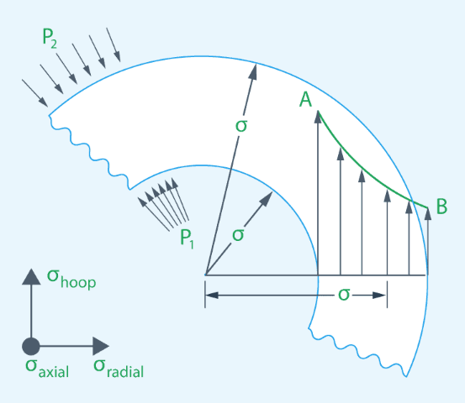
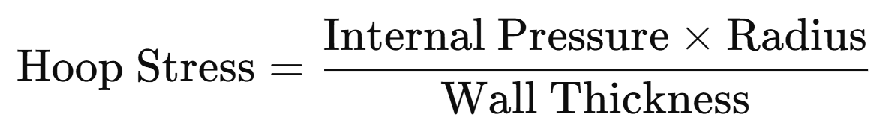
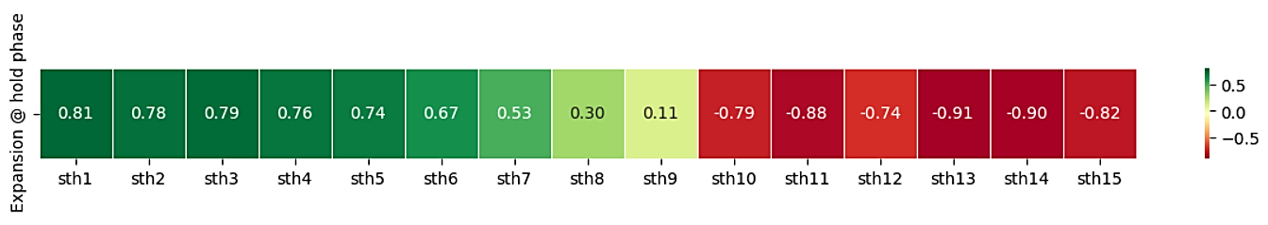
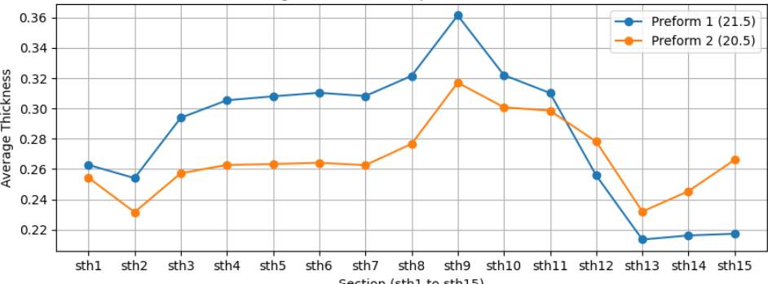
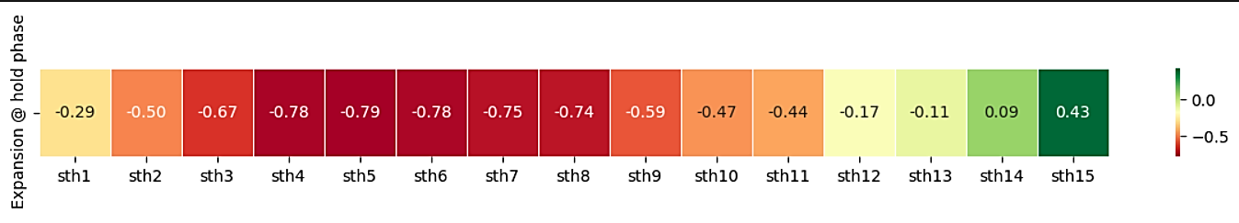
Burst Expansion: The thickness distribution in each preform plays a critical role in determining where the most burst expansion occurs.
Preform 21.5 & 20.5g
For the 21.5g preform, the burst expansion is focused on the lower thinner sections. For the 20.5g preform, the upper panel section (sth3 to sth7) experience more expansion because of the relative thinness, even though the lower sections are better supported by their thickness.
According to Laplace's Law, which applies to thin-walled pressure vessels like bottles, the relationship between internal pressure, wall thickness, and radius of the bottle can be expressed as:
Hence, thicker the wall, lower is the burst expansion.
However, behavior between Burst Expansion & Section Thickness is different for preform 21.5g and 20.5g:
Correlation Heatmap: Burst Expansion vs Section Thickness
Avg. Section Thickness by Preform
21.5g Preform
20.5g Preform
22
Laplace’s Law: Pressure Vessel, Thin Wall Hoop and Longitudinal Stresses Equation and Calculator (engineersedge.com)
Notes:
21.5g Preform: The upper sections (sth1 to sth9/10) are thicker, while the lower sections (sth11 to sth15) are much thinner. This results in more expansion in the lower part of the bottle, as thinner walls cannot resist the pressure as effectively.
20.5g Preform: In this preform, the lower sections are relatively thicker compared to the 21.5g preform, which provides more rigidity and less expansion in the lower part. The negative correlation across most of the bottle indicates that thinner sections expand more, as expected.

Slide 23
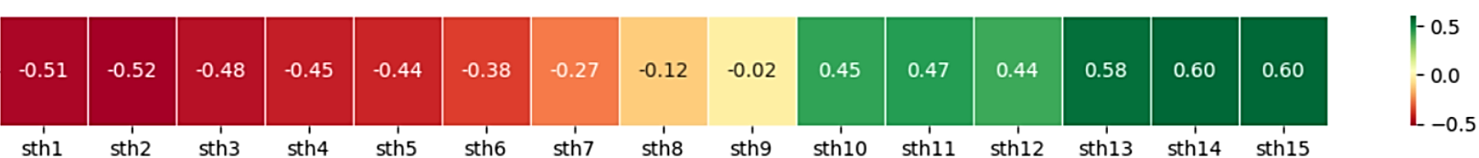
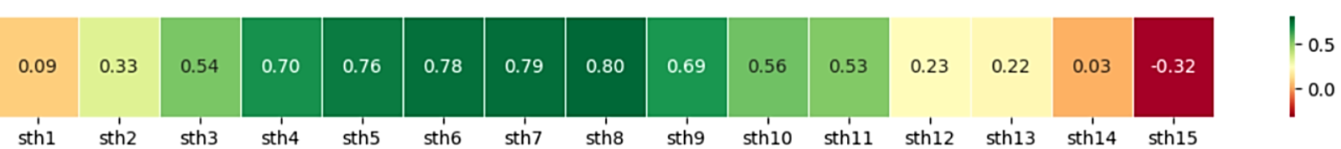
Burst Pressure: Greater the bottle thickness, higher is the burst pressure required to expand the bottle by 15%.
Preform 21.5 & 20.5g
As the wall thickness of the bottle increases, it requires a greater internal pressure to cause the bottle to expand, leading to smaller expansion values. According to the hoop stress, the thicker the walls, the more resistance the material has against internal pressure, requiring more force to achieve the same level of deformation.
Burst Pressure vs. Expansion – Preform 20.5g¹
Correlation Heatmap: Burst Pressure vs Section Thickness
21.5g Preform
20.5g Preform
For the 21.5 g preform, the lower parts of the bottle have relatively thinner walls. Increasing thickness in these areas improves burst resistance.
In the 20.5 g preform, the upper sections are thinner than those of the 21.5 g preform. By increasing the thickness in these areas, we can enhance burst resistance, thereby raising the pressure required for the bottle to burst.
23
Laplace’s Law: Pressure Vessel, Thin Wall Hoop and Longitudinal Stresses Equation and Calculator (engineersedge.com)

Slide 24
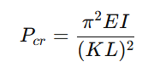
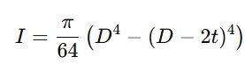
Empty Top Load Performance Relies on the Weakest Bottle Sections: Low Diameter and Reduced Thickness
Preform 21.5 & 20.5g
The performance of top load is primarily determined by the weakest sections of the bottle: thinner areas, which are more susceptible to buckling under lower loads due to reduced thickness, contrast with wider sections that enhance resistance to buckling through increased moment of inertia, thereby affecting overall structural integrity.
The overall load capacity of the bottle is determined by the minimum critical load across all sections, as the weakest point dictates overall stability; According to Euler’s formula for cylinder buckling, for each section, the critical load can be calculated as:
where,
Hence, The Empty top load depends on the smallest diameter (Grip section and Top section) and thickness.
 | Top Section | Grip Section
21.5g Preform
20.5g Preform
24
Notes:
For a bottle to perform well in empty top load testing, the grip section should be strengthened.
Upon analyzing the bottle failure cases for top load testing for both Preforms, we observed that failures predominantly occur when either the thicknesses at sections sth1 and sth2 are reduced (Lower Top Weight) or the thicknesses at sections sth9 to sth13 are compromised (Lower Grip section Weight).
This supports our hypothesis that a combination of lower thickness and reduced diameter significantly contributes to bottle failure during top load tests.

Slide 25
Other Results from Standard Models

Slide 26
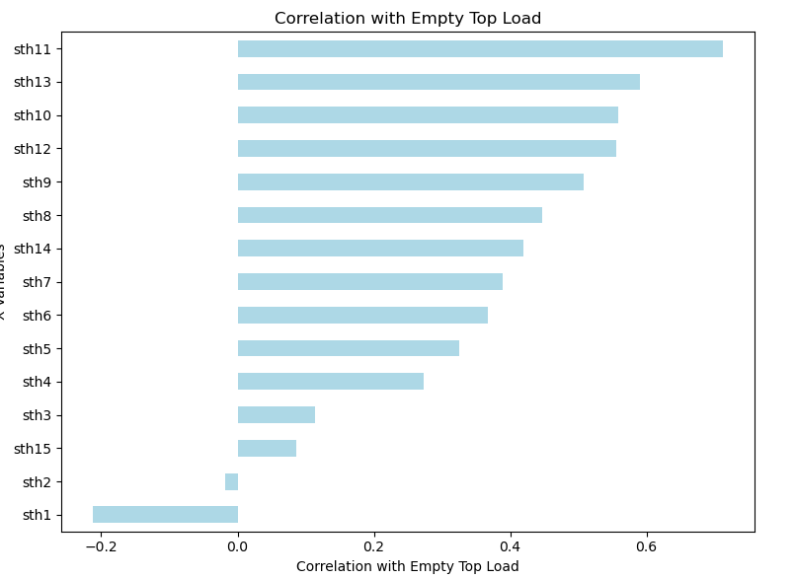
The Lasso Regression model has been chosen as the best baseline model for Empty Top Load.
Empty Top Load – AXL 20.5g
Initial models like Gradient Boosting and CatBoost showed strong performance but with overfitting, while Linear Regression was more balanced, though not fully capturing the data's complexity. Adding second-degree polynomial terms improved performance for Lasso Regression."
1. Model Input & Target Variables
3. Modeling Results
X Variables | sth1, sth2, sth3…….. sth15 (Section Thicknesses)
Y Variable | Empty Top Load
Step 3.1: Baseline Model Results
80:20 Train-Test Split¹
Model Type | R² Train | R² Test
Linear Regression | 0.76 | 0.81
Gradient Boosting | 1.00 | 0.79
CatBoost | 0.99 | 0.77
2. Correlation b/w Input & Target Variable
Is there potential to enhance the model through additional feature engineering?
Step 3.2: Modeling with Interaction Terms & Parameter Tuning
Thicknesses at the Grip Section have higher correlation with Empty Top Load
Model Type | R² Train | R² Test
Lasso Regression | 0.87 | 0.86
Metric Type | Example | Model Results
Feature Engineering | Sth1^2, 1/sth1, 1/sth1^2 | Adding these features did improve performance for some bottles but not for all.
Rate of Thickness Change | (sth1 – sth2)/sth1 | Drop in model performance
26
Notes:
For Empty Top Load, Sth11 had the highest correlation (~0.65), with the others showing gradually smaller correlations, so all variables were included for baseline modeling.
Reason for Choosing Lasso Regression: Lasso Regression delivered strong, consistent results across all preform types for Empty Top Load, with its simplicity and sparsity offering excellent explainability, making it an ideal choice.

Slide 27
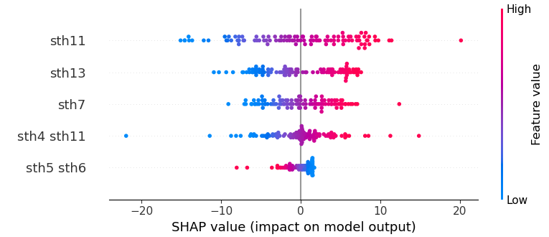
For Empty Top Load, sth11 is the most influential feature, followed by sth13 and sth7.
Empty Top Load – AXL 20.5g
The SHAP analysis reveals that sth11 has the greatest impact on predicting Empty Top Load, and the What-If Analysis setup closely forecasts actual values, demonstrating its effectiveness for automating predictions and optimizing bottle performance.
4. SHAP - Variable Importance
5. What-If Analysis
Based on the data provided, minimum and maximum upper bumper expansion are:
Upper Bumper Expansion | sth11 | sth13 | sth7 | sth4 | sth5
72.78 (Min) | 0.380 | 0.252 | 0.216 | 0.200 | 0.210
158.89 (Max) | 0.344 | 0.252 | 0.299 | 0.281 | 0.287
Using our What-If analysis setup, we can forecast the upper bumper expansion based on the input values for sth1 to sth15.
The predicted values from our What-If Analysis setup closely match the actual values, demonstrating that the model performs exceptionally well in forecasting Upper Bumper Expansion. Therefore, we recommend utilizing the What-If Analysis setup to automate the prediction process in this case.
sth11 is the most influential feature in predicting Empty Top Load, as it exhibits the highest impact on the model's output according to its SHAP values.
27
1: Multiple model split was tested such as 80:20 split, 50:50 split, etc. In this case, 80:20 split resulted the best model results.

Slide 28
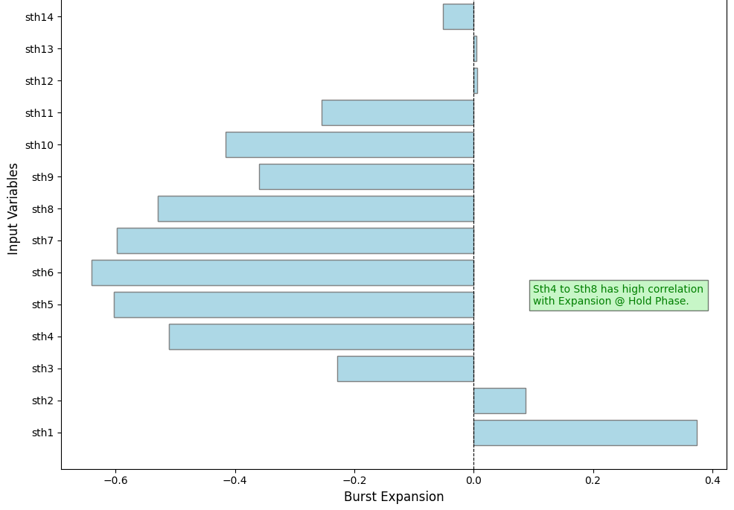
For Burst Expansion, Lasso Regression emerged as the best-performing model and was selected as the baseline for further modeling.
Burst Expansion
Initial models suffered from overfitting, with Linear Regression performing poorly until interaction terms and hyperparameter tuning improved results, while Lasso regression captured non-linear relationships effectively using polynomial features and regularization
1. Model Input & Target Variables
3. Modeling Results
X Variables | sth1, sth2, sth3…….. sth15 (Section Thicknesses)
Y Variable | Burst Expansion
Step 3.1: Baseline Model Results
80:20 Train-Test Split¹
Model Type | R² Train | R² Test
CatBoost | 0.99 | 0.93
Random Forest | 0.98 | 0.91
XGBoost | 1.00 | 0.89
2. Correlation b/w Input & Target Variable
Step 3.2: Modeling with Interaction Terms & Parameter Tuning
Model Type | R² Train | R² Test
Lasso Regression | 0.96 | 0.91
Sth4 to Sth8 has high correlation with Burst Expansion.
Is there potential to enhance the model through additional feature engineering?
Metric Type | Example | Model Results
Feature Engineering | Sth5, sth3^2, 1/sth10^2^2,sth11^2 | Adding these features did improve performance for some bottles but not for all.
Rate of Thickness Change | (sth1 – sth2)/sth1 | Drop in model performance
28
1: Correlation > |0.6| is considered as high correlation in our analysis.

Slide 29
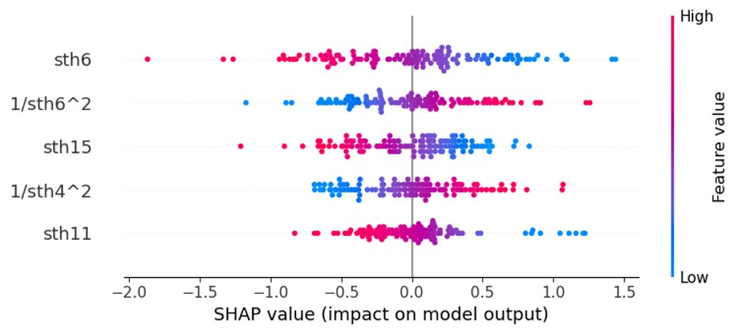
Sth6 is the Key Predictor for Burst Expansion, Followed by Sth15 and Sth11.
Upper Bumper Exp.
The SHAP analysis reveals that sth6 has the greatest impact on predicting Burst Expansion, and the What-If Analysis setup closely forecasts actual values, demonstrating its effectiveness for automating predictions and optimizing bottle performance.
4. SHAP - Variable Importance
5. What-If Analysis
Based on the data provided, minimum and maximum Burst Expansion are:
Burst Expansion | sth4 | sth5 | sth6 | sth7 | sth8
9.45 (Min) | 0.280 | 0.280 | 0.279 | 0.279 | 0.281
19.3 (Max) | 0.247 | 0.243 | 0.241 | 0.228 | 0.252
Using our What-If analysis setup, we can forecast the Burst Expansion based on the input values for sth4 to sth8.
The predicted values from our What-If Analysis setup closely match the actual values, demonstrating that the model performs exceptionally well in forecasting Upper Bumper Expansion. Therefore, we recommend utilizing the What-If Analysis setup to automate the prediction process in this case.
sth6 is the most influential feature in predicting Burst Expansion, as it exhibits the highest impact on the model's output according to its SHAP values.
29
1: Multiple model split was tested such as 80:20 split, 50:50 split, etc. In this case, 80:20 split resulted the best model results.

Slide 30
Non-Standard Models (Best Models)

Slide 31
Best Model Summary for AXL (20.5g, 21.6g) & Ripple Bottles.
Model Summary
The model developed for Ripple bottles demonstrates strong R2 performance across all bottle performance variables. However, for AXL bottles, while the model performs well for variables like top load and burst properties, it shows suboptimal results for thermal expansion metrics.
Note: Best Model* results for each performance metric & bottle type is shown here. |  | Bottle Type
 |  | 21.5g (AXL) |  | 20.5g (AXL) |  | 20.5g (Ripple) |  | 20.5g (Ripple FENC)
 |  | Model Type | R2 (Train | Test) | Model Type | R2 (Train | Test) | Model Type | R2 (Train | Test) | Model Type | R2 (Train | Test)
Bottle Performance (Y) | Upper Bumper Expansion | Linear Regression | 0.32 | 0.32 | AdaBoost | 0.79 | 0.30 | Linear Regression | 0.97 | 0.95 | Linear Regression | 0.98 | 0.95
 | Upper Panel Expansion | Random Forest | 0.59 | 0.34 | AdaBoost | 0.59 | 0.34 | Linear Regression | 0.98 | 0.98 | Linear Regression | 0.98 | 0.95
 | Mid Panel Expansion | Adaboost | 0.63 | 0.26 | Gradient Boosting | 0.89 | 0.44 | Linear Regression | 0.97 | 0.95 | Ridge Regression | 0.97|0.94
 | Lower Panel Expansion | CatBoost | 0.66 | 0.26 | CatBoost | 0.99 | 0.43 | Linear Regression | 0.96 | 0.93 | Linear Regression | 0.96|0.86
 | Lower Bumper Expansion | Adaboost | 0.58 | 0.58 | Decision Tree | 1.00 | 0.57 | Linear Regression | 0.97 | 0.94 | Linear Regression | 0.97 | 0.87
 | Base Expansion | Gradient Boosting | 0.96 | 0.53 | Linear Regression | 0.077 | 0.062 | - | - | - | -
 | Empty Top Load | Linear Regression | 0.99| 0.98 | Linear Regression | 0.87 | 0.86 | XGBoost | 1.00 | 0.64 | Ridge Regression | 0.99 | 0.77
 | Burst Expansion | Linear Regression | 0.99| 0.98 | Linear Regression | 0.99 | 0.98 | Linear Regression | 0.97 | 0.92 | - | -
 | Burst Pressure | Gradient Boosting | 0.99 | 0.97 | Gradient Boosting | 0.99 | 0.94 | CatBoost | 0.99 | 0.93 | - | -
 | Panel Max Expansion | - | - | - | - | CatBoost | 0.99 | 0.92 | Linear Regression | 0.97 | 0.83
Model Performance:
31
*: Best Model results are based on the R2 values of the train & test data. 1: Top variables are based on variable importance/SHAP importance plot.

Slide 32
Other Results from Standard Models

Slide 33
Upper Panel Expansion – Ripple 20.5g

Slide 34
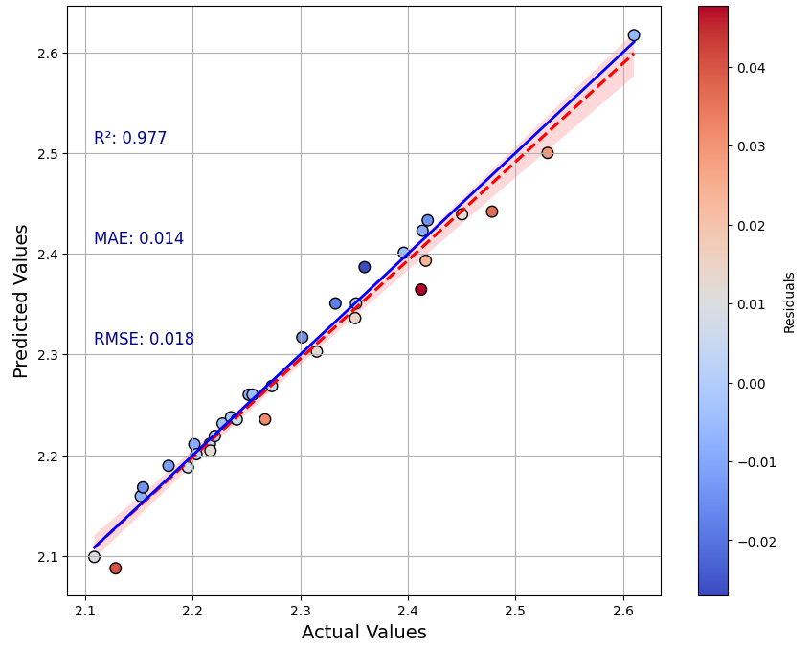
Upper Panel Expansion: Model performs exceptionally well with a high R² score for 20.5g Ripple Bottle.
20.5g (Ripple)
Initially, models like Gradient Boosting and Random Forest achieved the highest accuracy (R² Test ~0.97) using raw features. However, adding interaction terms significantly boosted accuracy, allowing a Linear Regression model with feature engineering to achieve a balanced Train and Test R² of 0.98, offering both high accuracy and interpretability.
Model Input & Outputs
Actual vs Predicted Values – Model with Interaction Terms
X Variables | sth1, sth2, sth3…….. sth15 (Section Thicknesses)
Y Variable | Upper Panel Thermal Expansion
80:20 Train-Test Split
Step 1: Base Model Results
Model Type | R² Train | R² Test
Linear Regression | 0.95 | 0.93
Random Forest | 0.99 | 0.97
Gradient Boosting | 1.00 | 0.97
XGBoost | 1.00 | 0.96
AdaBoost | 0.98 | 0.96
CatBoost | 1.00 | 0.96
The predictions are highly aligned with the actual values, as indicated by the scatter plot and the alignment with the diagonal line.
Step 2: Modeling with Interaction Terms & Parameter Tuning
Model Type | R² Train | R² Test
Linear Regression | 0.98 | 0.98
34

Slide 35
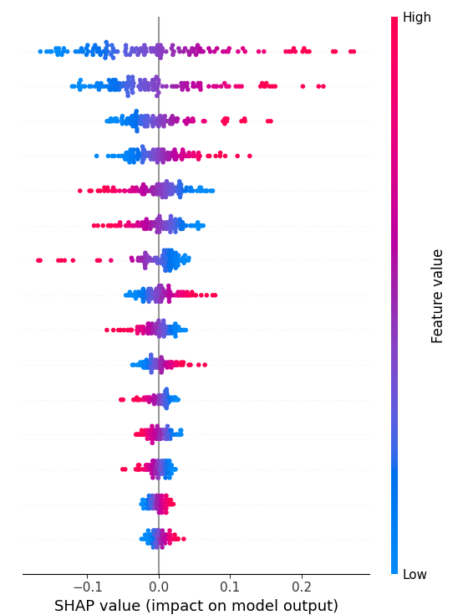
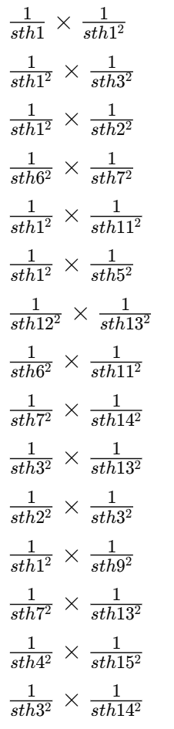
Upper Panel Expansion: Interaction terms in between sth1, sth2 and sth3 are the top x drivers for 20.5g Ripple bottle.
20.5g (Ripple)
During testing, the bottles are subjected to thermal expansion due to heat in the environmental chamber. PET material responds to heat by expanding, especially in areas where the material is thinner or has a lower modulus.
SHAP Importance
Chain Reaction in the Bottle Structure
Why sth1, sth2
& sth3?
In the bottle’s upper region:
Sth1 (shoulder) has a lower modulus and section thickness value, which means it expands more when heated.
This expansion causes the stress to be pushed downward into sth2 and sth3.
Even though sth2 is stiffer, the stress buildup in sth1 and sth3 leads to radial deformation at sth4.
The measured expansion at sth4 is a result of the cumulative radial deformation from the sections above it.
35

Slide 36
Upper Panel Expansion – AXL 20.5g

Slide 37
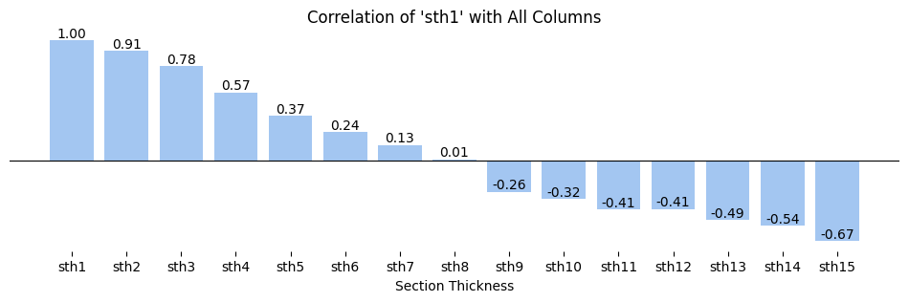
Upper Panel Expansion: The performance of the baseline model remains suboptimal, showing an R² score of only 0.25 after using the chosen features.
20.5g (AXL)
The slide highlights the influence of section thickness values (sth1 to sth5) on thermal expansion and the challenge of multicollinearity among these features. By testing multiple models, the AdaBoost model using a refined feature set achieved the best R² score, indicating a more reliable prediction approach.
Model Input & Outputs
Why base models yielded bad results (R2)?
X Variables | sth1, sth2, sth3…….. sth15 (Section Thicknesses)
Y Variable | Upper Panel Thermal Expansion
Correlation between Sth1 vs. Other thickness values
The first few sections show high positive correlations close to 1. Hence, multicollinearity.
50:50 Train-Test Split¹
Base Model Results
Model Type | R² Train | R² Test
Linear Regression | 0.32 | -0.48
Random Forest | 0.86 | 0.06
Gradient Boosting | 0.99 | 0.03
XGBoost | 0.99 | 0.01
AdaBoost | 0.83 | 0.03
Decision Tree | 1.00 | -0.65
Bagging | 0.77 | 0.03
Extra Trees | 1.00 | 0.09
KNN | 0.25 | -0.09
Solution – Use the best combination of Sth value
Our cohort analysis revealed that the sth values from 1 to 5 are the key drivers influencing “Upper Panel Expansion.“ Additionally, after conducting 32,767 iterations using various combinations of input variables, the AdaBoost model achieved the highest baseline R² score when using sth2, sth3, sth4, and sth5 as predictors.
Model Type | R² Train | R² Test
AdaBoost (sth2, sth3, sth4, sth5) | 0.69 | 0.25
37
1: Multiple model split was tested such as 80:20 split, 50:50 split, etc. In this case, 50:50 split resulted the best model results.

Slide 38
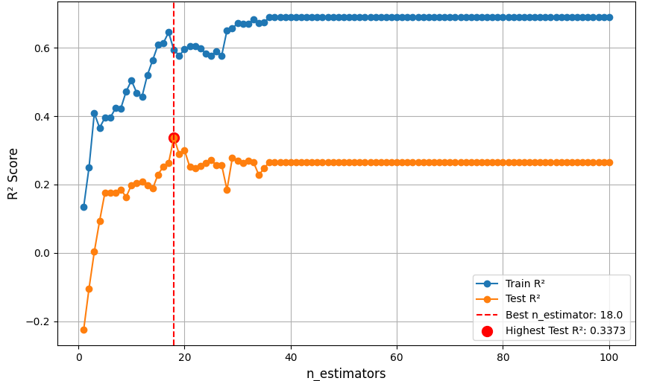
Upper Panel Expansion: Optimizing the AdaBoost model with `n_estimators = 18` resulted in the best performance, achieving a test R² score of 0.34.
20.5g (AXL)
Adding interaction terms (e.g., 𝑠𝑡ℎ1×𝑠𝑡ℎ2sth1×sth2) and rate of thickness change features did not improve the AdaBoost model's test R2 . While the training accuracy was high (R2 = 0.71), the low test R2 (below 0.3) indicates these features did not enhance model generalization, likely due to overfitting.
Selected Model Input¹ & Outputs
Is there potential to enhance the model through feature engineering?
X Variables | sth2, sth3, sth4 and sth5 (Selected based on previous slide)
Y Variable | Upper Panel Thermal Expansion
1. Using Interaction Terms
2- and 3-degree Interaction terms in between sth values are created to see if complex relationships between different sections of the bottle could captured and how they impact the upper panel expansion.
Metric Example: sth1 x sth2 (2-degree: ), sth1 x sth7 x sth10 (3-degree)
However, adding this variables didn’t improve the model performance:
50:50 Train-Test Split
AdaBoost Model Tuning² –“n-estimators” vs. Model Performance (R2)
Model Type | R² Train | R² Test
AdaBoost | 0.71 | 0.28
2. Using Rate of Thickness Change (%) Terms
The introduction of a rate of thickness change features was introduced to capture how the transition between adjacent sections influences the upper panel expansion. Exemplar rule for the metric:
Rate of Thickness Change = (𝑠𝑡ℎ2−𝑠𝑡ℎ1)/𝑠𝑡ℎ1
However, adding this variables didn’t improve the model performance:
Model Type | R² Train | R² Test
AdaBoost | 0.71 | 0.26
38
1: Only “sth2, sth3, sth4, and sth5” are added as the input into the model here.
2: We conducted a grid search to optimize the model's hyperparameters. However, the only parameter that led to an improvement in model performance was `n_estimators`.

Slide 39
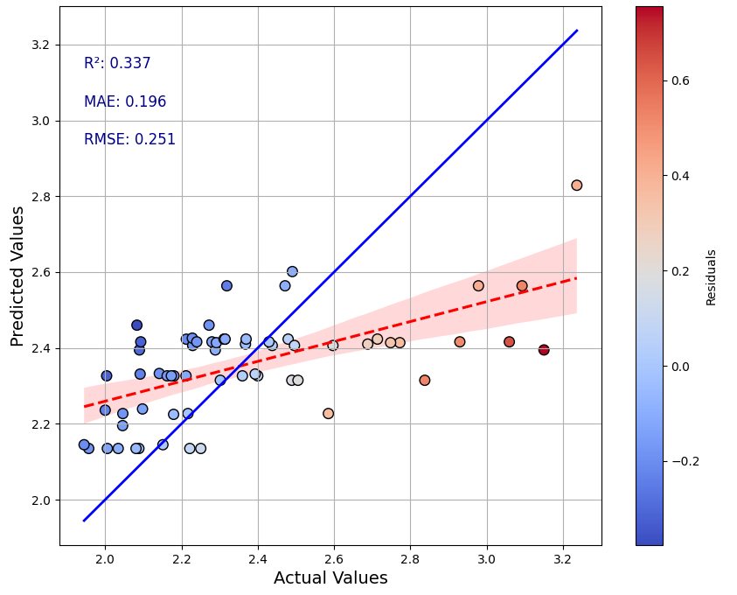
With a R2 of 0.34, the model is underperforming, especially for higher actual values of Upper Panel Expansion.
20.5g (AXL)
Given that the model only explains about 33.7% of the variance in the actual data, it is not advisable to rely solely on the model’s predictions for determining the optimal bottle performance.
Actual vs Predicted Values – Best Model (n_estimators = 18)
Fit Line Analysis
The solid blue line represents a perfect fit where predictions are exactly equal to the actual values.
The red dashed line is the regression line based on the model’s predictions. The fact that the red line deviates significantly from the blue line suggests that the model has a bias issue, likely underpredicting values as they increase.
Residuals Analysis (Color-coded)
The color bar indicates the magnitude of residuals (difference between predicted and actual values).
Blue dots represent lower residuals (better predictions), while red dots indicate higher residuals (poorer predictions).
The plot shows that:
Many of the blue points are clustered around lower actual values, indicating the model performs better for smaller target values.
As the actual values increase (towards the right side of the plot), there are more red points, showing that the model struggles with underpredicting higher values.
39

Slide 40
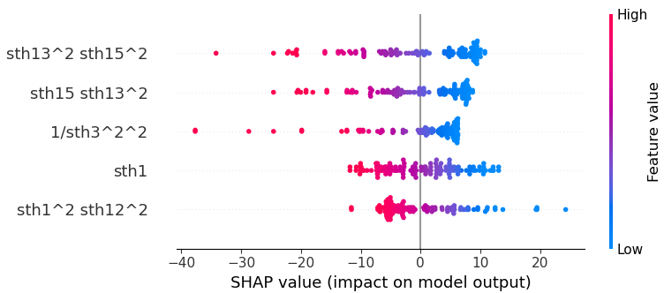
Empty Top Load: Model performs exceptionally well with a high R² score for 21.5g AXL Bottle.
21.5g (AXL)
Initially, models like Gradient Boosting and XGBoost achieved the highest accuracy (R² Test ~0.98) using raw features. However, adding interaction terms significantly boosted accuracy, allowing a Lasso Regression model with feature engineering to achieve a balanced Train and Test R² of 0.98, offering both high accuracy and interpretability.
Model Input & Outputs
SHAP Importance
X Variables | sth1, sth2, sth3…….. sth15 (Section Thicknesses)
Y Variable | Empty Top Load
We used pipelines with spot-checking to evaluate models and tune hyperparameters using neg_mean_abs_err as a metric
80:20 Train-Test Split
Step 1: Model Results with Base Variables
Model Type | R² Train | R² Test
Linear Regression | 0.78 | 0.61
Gradient Boosting | 0.99 | 0.98
CatBoost | 0.99 | 0.93
XGB | 0.98 | 0.96
Step 2: Modeling with Interaction Terms & Parameter Tuning
Model Type | R² Train | R² Test
Lasso Regression | 0.99 | 0.98
40
Notes:
For modeling Empty Top Load, we used spot-checking methods to evaluate various machine learning models suitable for predicting continuous values, with the metric of neg_mean_abs_err (since scikit-learn uses negative metrics to ensure lower values are always better). Using pipelines to explore different data preprocessing methods, we identified the best-performing models and conducted hyperparameter tuning. XGBoost, CatBoost, and Gradient Boosting performed well with the base features, achieving a Train R² of 0.99 and Test R² of 0.98. However, for more interpretable models, we applied feature engineering and improved a Lasso regression model's Train R² from 0.78 to 0.99 and Test R² from 0.61 to 0.98.

Slide 41
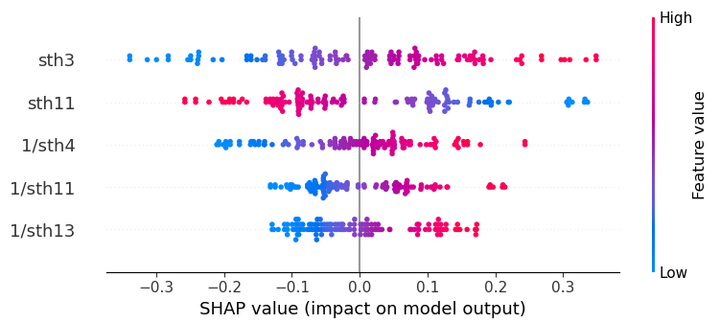
Expansion @ hold phase: Model performs exceptionally well with a high R² score for 21.5g AXL Bottle.
21.5g (AXL)
Initially, models like CatBoost achieved the highest accuracy (R² Test ~0.98) using raw features. However, adding interaction terms significantly boosted accuracy, allowing a Lasso Regression model with feature engineering to achieve a balanced Train and Test R² of 0.98, offering both high accuracy and interpretability.
Model Input & Outputs
SHAP Importance
X Variables | sth1, sth2, sth3…….. sth15 (Section Thicknesses)
Y Variable | Empty Top Load
We used pipelines with spot-checking to evaluate models and tune hyperparameters using neg_mean_abs_err as a metric
80:20 Train-Test Split
Step 1: Model Results with Base Variables
Model Type | R² Train | R² Test
Linear Regression | 0.96 | 0.96
Gradient Boosting | 1.00 | 0.96
CatBoost | 1.00 | 0.98
CART | 1.00 | 0.95
Step 2: Modeling with Interaction Terms & Parameter Tuning
Model Type | R² Train | R² Test
Lasso Regression | 0.99 | 0.98
41
Notes:
For modeling, we used spot-checking methods to evaluate various machine learning models suitable for predicting continuous values, with the metric of neg_mean_abs_err (since scikit-learn uses negative metrics to ensure lower values are always better). Using pipelines to explore different data preprocessing methods, we identified the best-performing models and conducted hyperparameter tuning. XGBoost, CatBoost, and Gradient Boosting performed well with the base features, achieving a Train R² of 0.99 and Test R² of 0.98. However, for more interpretable models, we applied feature engineering and improved a Lasso regression model's Train R² from 0.78 to 0.99 and Test R² from 0.61 to 0.98.

Slide 42
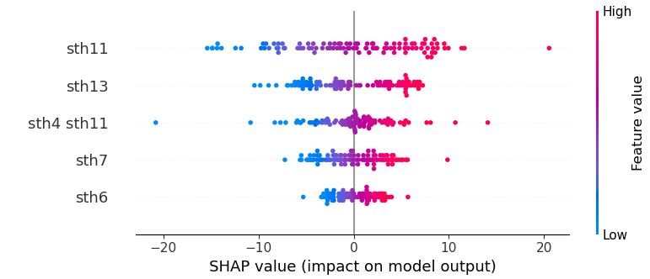
Empty Top Load: Model performs well with a high R² score for 20.5g AXL Bottle.
20.5g (AXL)
Initially, models like Gradient Boosting and CatBoost achieved the highest accuracy (R² Test ~0.79) using raw features. However, adding interaction terms significantly boosted accuracy, allowing a Lasso Regression model with feature engineering to achieve a balanced Train and Test R² of 0.86, offering both high accuracy and interpretability.
Model Input & Outputs
SHAP Importance
X Variables | sth1, sth2, sth3…….. sth15 (Section Thicknesses)
Y Variable | Empty Top Load
We used pipelines with spot-checking to evaluate models and tune hyperparameters using neg_mean_abs_err as a metric
80:20 Train-Test Split
Step 1: Model Results with Base Variables
Model Type | R² Train | R² Test
Linear Regression | 0.76 | 0.81
Gradient Boosting | 1.00 | 0.79
CatBoost | 0.99 | 0.77
Step 2: Modeling with Interaction Terms & Parameter Tuning
Model Type | R² Train | R² Test
Lasso Regression | 0.87 | 0.86
42
Notes:
For modeling Empty Top Load, we used spot-checking methods to evaluate various machine learning models suitable for predicting continuous values, with the metric of neg_mean_abs_err (since scikit-learn uses negative metrics to ensure lower values are always better). Using pipelines to explore different data preprocessing methods, we identified the best-performing models and conducted hyperparameter tuning. XGBoost, CatBoost, and Gradient Boosting performed well with the base features, achieving a Train R² of 0.99 and Test R² of 0.98. However, for more interpretable models, we applied feature engineering and improved a Lasso regression model's Train R² from 0.78 to 0.99 and Test R² from 0.61 to 0.98.

Slide 43
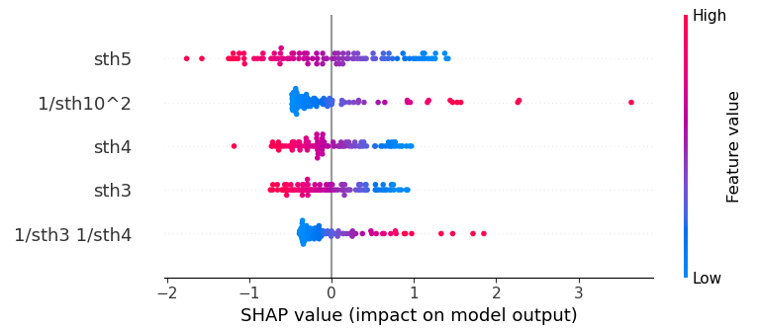
Expansion @ hold phase: Model performs exceptionally well with a high R² score for 20.5g AXL Bottle.
20.5g (AXL)
Initially, models like CatBoost achieved the highest accuracy (R² Test ~0.96) using raw features. However, adding interaction terms significantly boosted accuracy, allowing a Lasso Regression model with feature engineering to achieve a balanced Train and Test R² of 0.98, offering both high accuracy and interpretability.
Model Input & Outputs
SHAP Importance
X Variables | sth1, sth2, sth3…….. sth15 (Section Thicknesses)
Y Variable | Empty Top Load
We used pipelines with spot-checking to evaluate models and tune hyperparameters using neg_mean_abs_err as a metric
80:20 Train-Test Split
Step 1: Model Results with Base Variables
Model Type | R² Train | R² Test
Linear Regression | 0.95 | 0.93
Gradient Boosting | 1.00 | 0.93
LightGBM | 0.99 | 0.94
CatBoost | 1.00 | 0.96
Step 2: Modeling with Interaction Terms & Parameter Tuning
Model Type | R² Train | R² Test
Lasso Regression | 0.99 | 0.98
43
Notes:
For modeling, we used spot-checking methods to evaluate various machine learning models suitable for predicting continuous values, with the metric of neg_mean_abs_err (since scikit-learn uses negative metrics to ensure lower values are always better). Using pipelines to explore different data preprocessing methods, we identified the best-performing models and conducted hyperparameter tuning. XGBoost, CatBoost, and Gradient Boosting performed well with the base features, achieving a Train R² of 0.99 and Test R² of 0.98. However, for more interpretable models, we applied feature engineering and improved a Lasso regression model's Train R² from 0.78 to 0.99 and Test R² from 0.61 to 0.98.

Slide 44
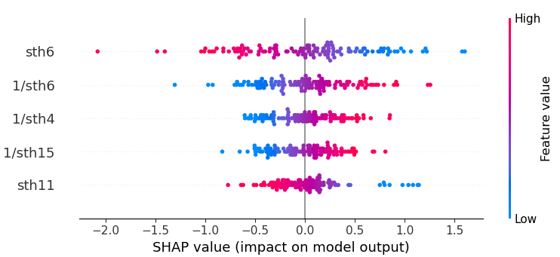
Expansion @ hold phase: Model performs well with a high R² score for 20.5g Ripple Bottle.
20.5g (Ripple)
Initially, models like Gradient Boosting achieved the highest accuracy (R² Test ~0.92) using raw features. However, adding interaction terms significantly boosted accuracy, allowing a Lasso Regression model with feature engineering to achieve a balanced Train and Test R² of 0.98, offering both high accuracy and interpretability.
Model Input & Outputs
SHAP Importance
X Variables | sth1, sth2, sth3…….. sth15 (Section Thicknesses)
Y Variable | Empty Top Load
We used pipelines with spot-checking to evaluate models and tune hyperparameters using neg_mean_abs_err as a metric
80:20 Train-Test Split
Step 1: Model Results with Base Variables
Model Type | R² Train | R² Test
Linear Regression | 0.90 | 0.88
Gradient Boosting | 1.00 | 0.92
LightGBM | 0.99 | 0.89
Random Forest | 0.98 | 0.90
CatBoost | 0.99 | 0.90
Step 2: Modeling with Interaction Terms & Parameter Tuning
Model Type | R² Train | R² Test
Lasso Regression | 0.97 | 0.92
44
Notes:
For modeling, we used spot-checking methods to evaluate various machine learning models suitable for predicting continuous values, with the metric of neg_mean_abs_err (since scikit-learn uses negative metrics to ensure lower values are always better). Using pipelines to explore different data preprocessing methods, we identified the best-performing models and conducted hyperparameter tuning. XGBoost, CatBoost, and Gradient Boosting performed well with the base features, achieving a Train R² of 0.99 and Test R² of 0.98. However, for more interpretable models, we applied feature engineering and improved a Lasso regression model's Train R² from 0.78 to 0.99 and Test R² from 0.61 to 0.98.

